Slide 1
Department of Computer Science and Engineering
NETWORK SECURITY
Pooja
Programmer, CSE Deptt.

Slide 2
INTRUSION DETECTION SYSTEM

Slide 3
CONTENT
Introduction
What is Intrusion
Need of Intrusion Detection System
What is IDS
Functions
Types
Conclusion

Slide 4
INTRODUCTION
An intrusion detection system (IDS)
monitors network traffic and monitors
for suspicious activity and alerts the
System or network administrator.
In some cases, the IDSmay also respond
to anomalous or malicious traffic by
taking action such as blocking the
user or source IP address from accessing
the network.

Slide 6
What is Intrusion
THREAT TO NETWORK SECURITY
A significant security problem for networked system is,
or at least unwanted, trespass by users or software.
Intrusion : Attempting to break into or misuse your system.
Intruders may be from outside the network or legitimate users of the network.
Intrusion can be a physical, system or remote intrusion.

Slide 7
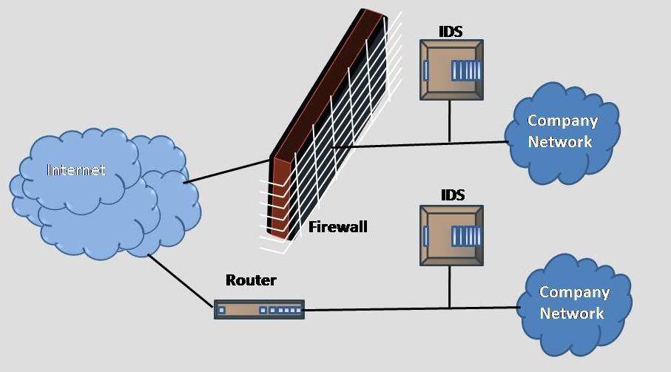
INTRUSION DETECTION SYSTEM

Slide 8
NEED OF INTRUSION DETECTION SYSTEM
An Intrusion detection system (IDS) is a
security system that monitors computer
systems and network traffic and analyzes
that traffic for possible hostile attacks
originating from outside the organization
and also for system misuse or attacks
originating from inside the organization.

Slide 9
FUNCTIONS OF IDS
An IDS detects attacks as soon as possible
and takes appropriate action.
An IDS does not usually take preventive
measures when an attack is detected.
It is a reactive rather than a pro-active
agent.
It plays a role of informant rather than
a police officer.

Slide 10
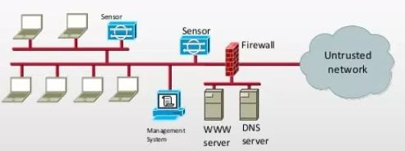
TYPES OF IDS
NIDS :-
A network intrusion detection system (NIDS)
is an independent platform which identifies
intrusions by examining network traffic and
monitors multiple hosts . An example of a NIDS
is Snort.

Slide 11
NIDS :-
Monitor activity on the network for
Known attacks
Suspicious network activity
Designed to detect attacks such as
Denial of service
Network probes
Malformed packets, etc.
Can be some overlap with firewall

Slide 12
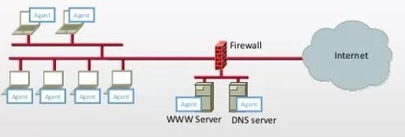
HIDS :-
A host-based intrusion detection system (HIDS)
consists of an agent on a host which identifies
intrusions by analyzing system calls, application
logs, file-system modifications (binaries, password
files, capability/acl databases) and other host
activities and state. An example of a HIDS is OSSEC.

Slide 13
HIDS :-
Monitor activities on hosts for
Known attacks or
Suspicious behavior
Designed to detect attacks such as
Buffer overflow
Escalation of privilege
Little or no view of network activities

Slide 14
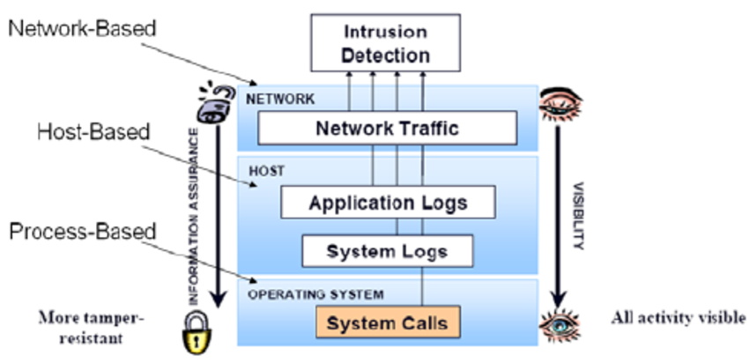
Application – Based IDS :-
An application-based IDS is like a host-based IDS
designed to monitor a specific application(similar
to antivirus software designed specifically to monitor
your mail server). An application-based IDS is
extremely accurate in detecting malicious activity
for the applications it protects.

Slide 15
CONCLUSION
Future research trends seem to be converging
towards a model that is hybrid of the anomaly and
misuse detection models.
It is slowly acknowledged that neither of the models
can detect all intrusion attempts on their own.

